Slide 1

E-COURT MANAGEMENT SYSTEM

Slide 2
A Project Report On “E-COURT MANAGEMENT SYSTEM”
Savitribai Phule Pune University
Developed By
Mr. RAVI D. BAMBLE
Mr. SUSHANT ANIL JADHAV

Slide 3
Problem Definition
As we observe in earliest days court management system work manually. Now we worked on the court management system computerized online manner.
In manual work all the Court Management work is on paper and the plaintiff who went to register case he has to face so many problems in manual work in short manual process is very vast, wastage of time and difficult for client also in this manual process so many papers get wasted and the data lost also occur because of this paper so many files are pending and this files occupy lots of space.
Now we work on project of online code management system by this process client of plaintiff can easily communicate with administration process of court or plaintiff FIR process becomes very easy and convenient to client.
So online court management system is time saving to client they can easily communicate with the respective lawyer. So this will be no wastage of paper also no data loss the data will remain secured to the respective person admin.

Slide 4
Existing System
The existing system of court management system all entries are done manually. There is no online system available it requires,More paper workings.
Needs manual work which is time consuming.
Data loss occurred due to many files and papers
Drawbacks of Existing System
It requires lots of paper works and each time meeting.
Maintaining records and generating paper of several cases become difficult
Record missing issue may occur while cases are in process.

Slide 5
Motivation
Motivation behind doing this project was primarily an interest in undertaking a challenging project in an interesting area of research.

Slide 6
Scope of the System
The system provides proper security and reduces the manual work and easy to find detailed of client and lawyer and browsing the plans.
Security of data.
Ensure data accuracy.
Found record rapidly.
Minimize manual data entries.
Better service.
User friendly.

Slide 7
Feasibility study
Technical feasibility :
The technical feasibility always focuses on existing computer hardware software and so personnel.
It needs to consider the machine availability and nature of hardware and software being used.
System is portable since it can be used on any machine and number of additional hardware is required.
The project backend is PostgresSQL.
Operational feasibility
Technical experts consulting cost.
Equipment purchases cost.
Communication equipments cost.
Operating system software cost.
Application software cost.
Documentation preparation cost.
Economic feasibility :
It considered the cost/benefits analysis of the proposed project the benefit are always expected to over waiting the costs.
Economic feasibility is helpful to find the system development cost and check whether it is justificable for that we it checks

Slide 8
Requirement Analysis
Hardware Requirement(Minimum) :
Processor - Intel i3/AMD Make
RAM Size - 4GB
HDD - 500GB
Key Board - Standard Windows Keyboard
Mouse - Any
Software Requirement(Minimum) :
Operating System - Windows Platform(Windows 7 or greater)

Slide 9
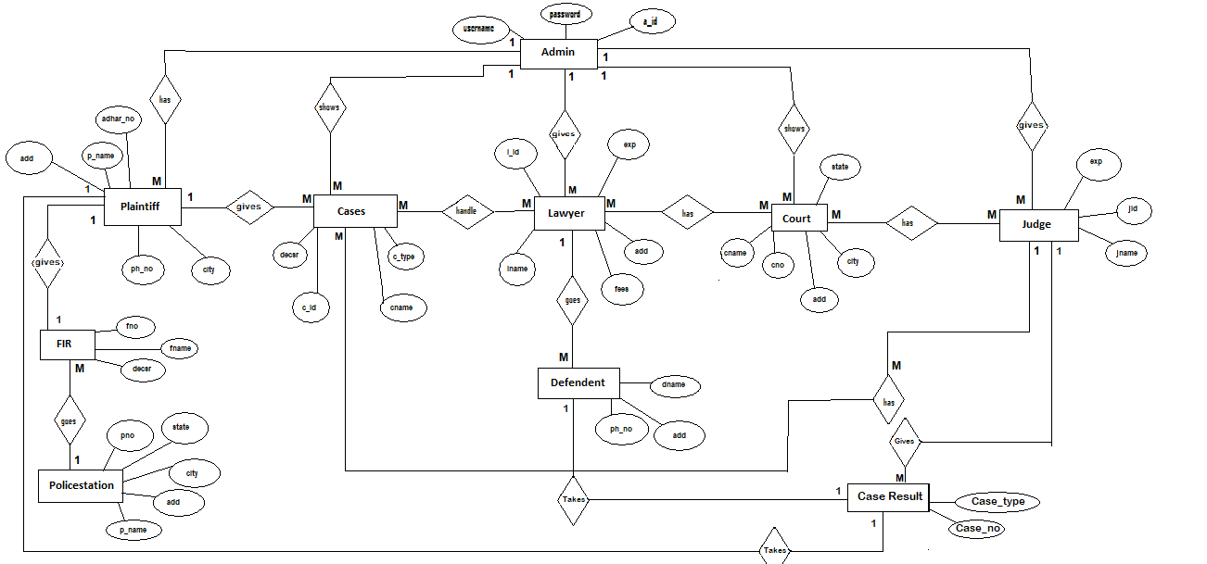
E-R diagram

Slide 10
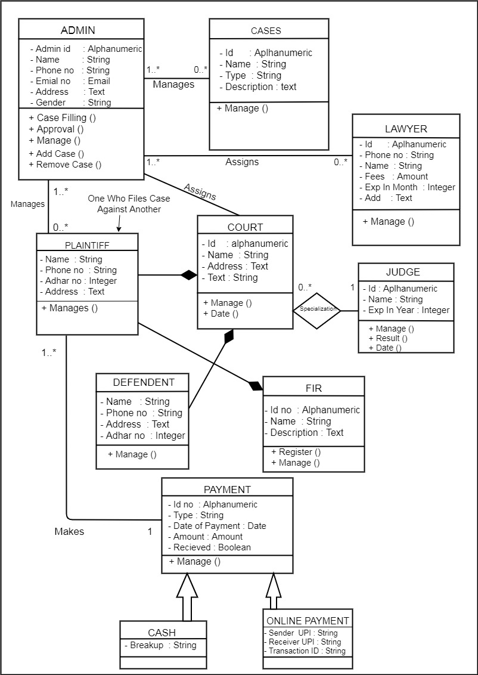
UML Diagrams

Slide 11
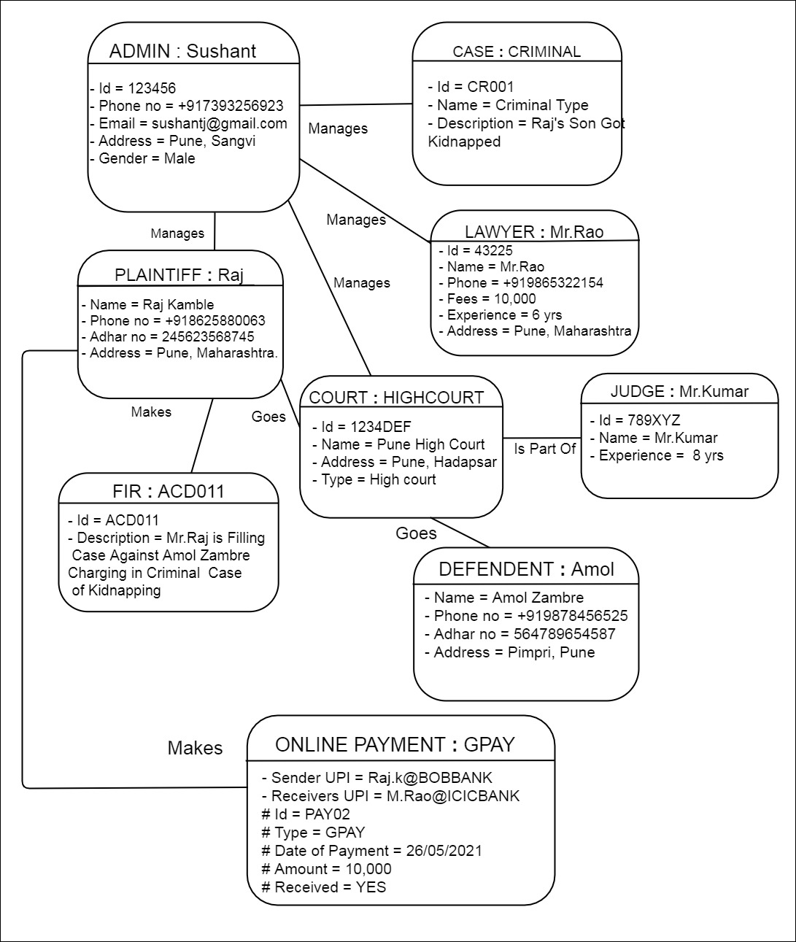

Slide 12
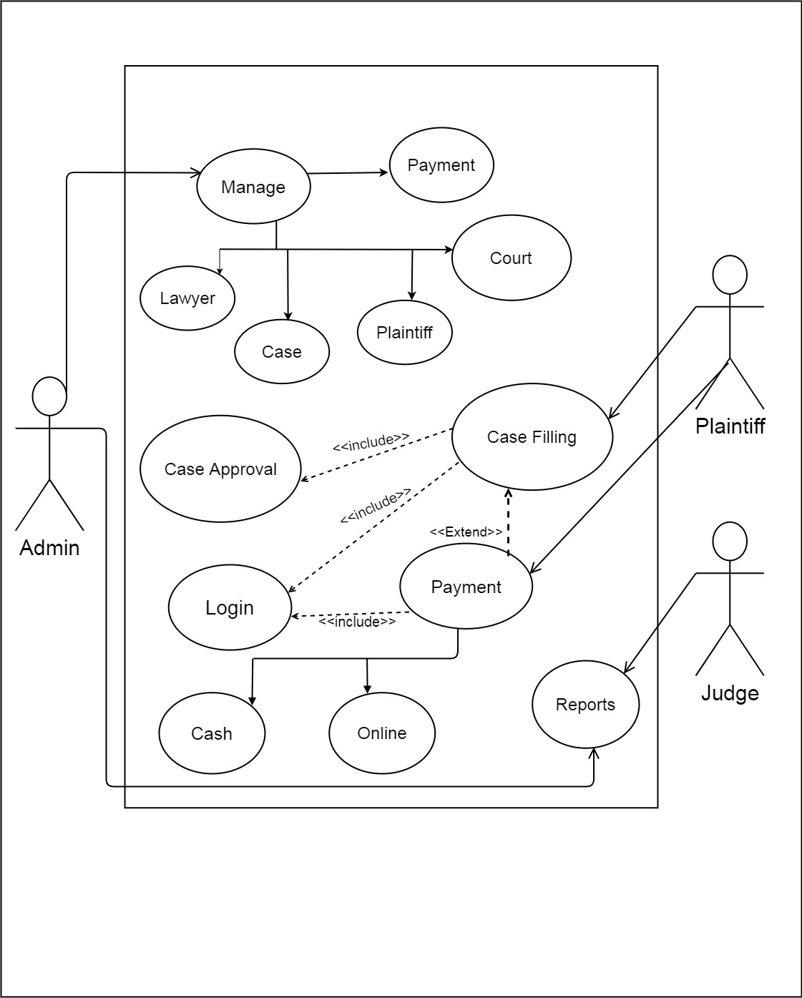

Slide 13
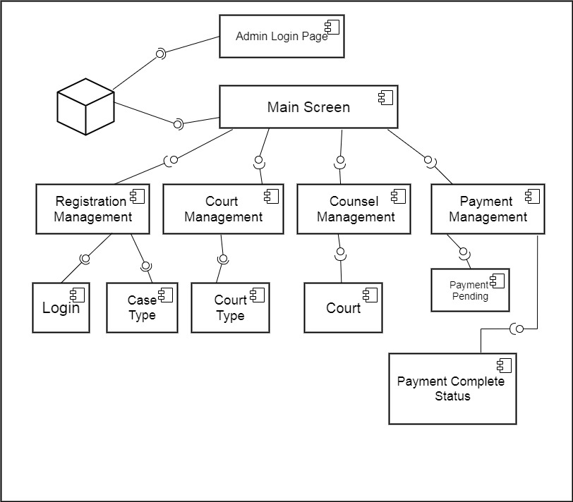

Slide 14
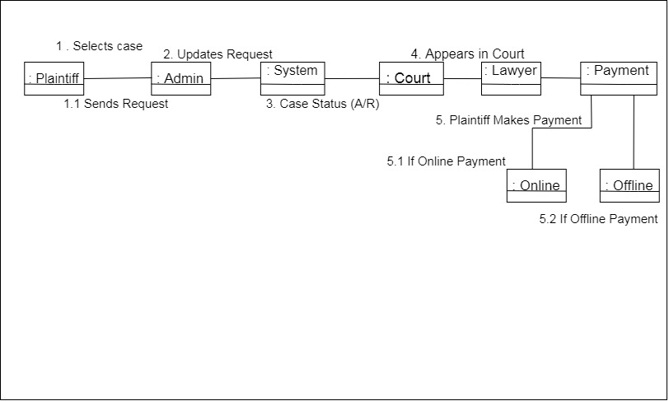

Slide 15
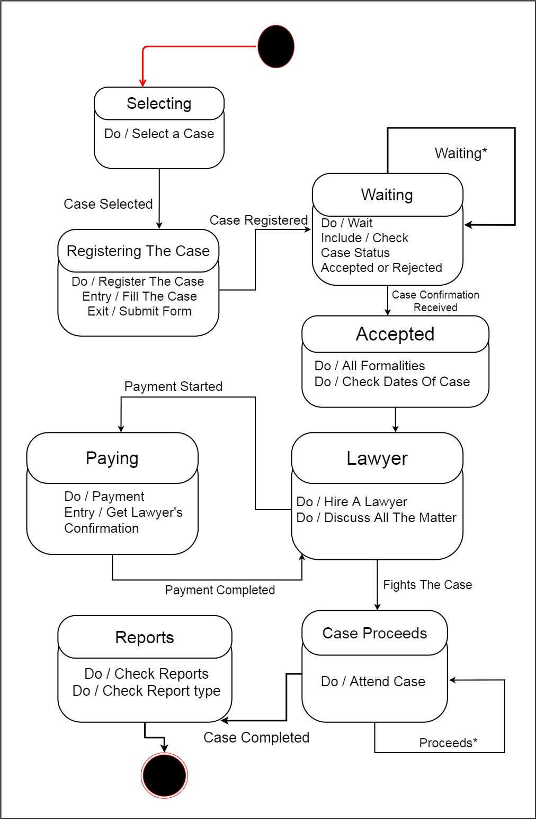

Slide 16
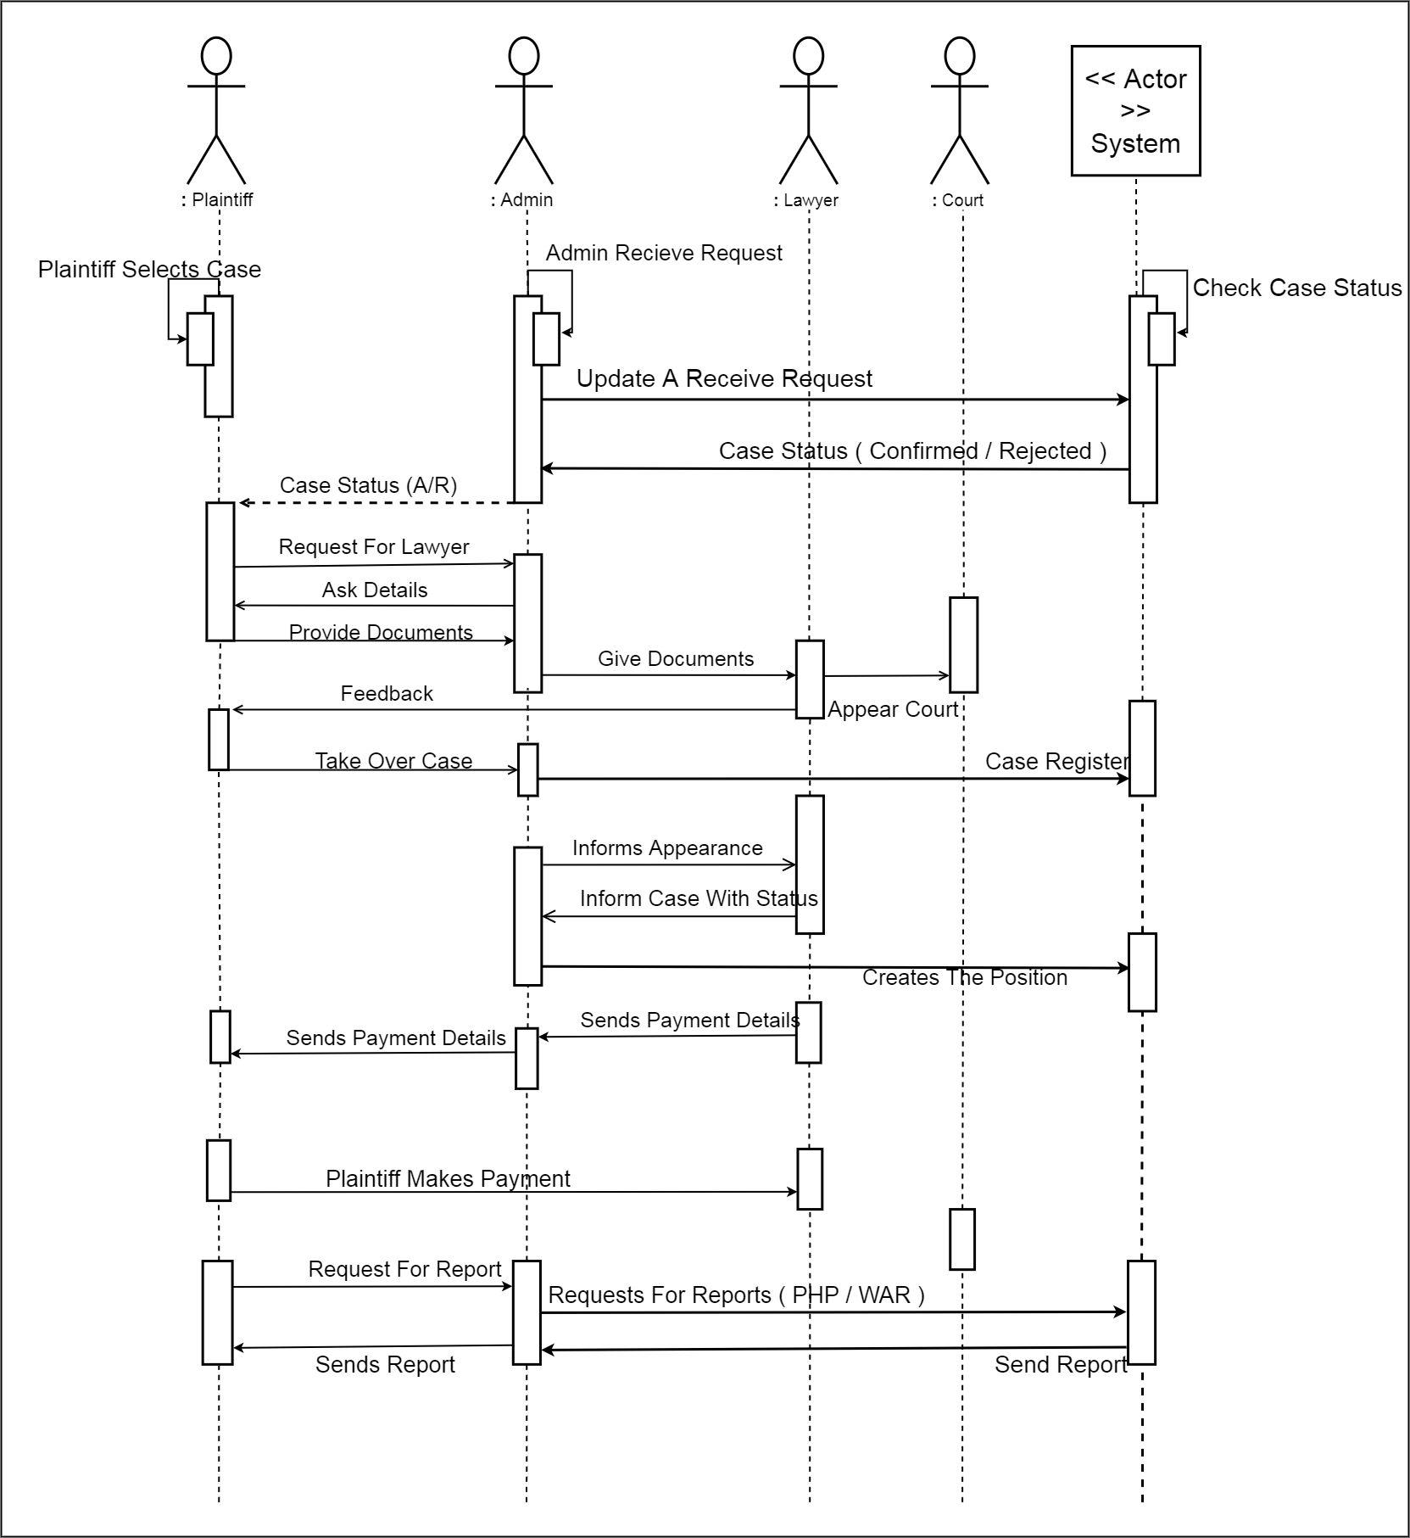

Slide 17
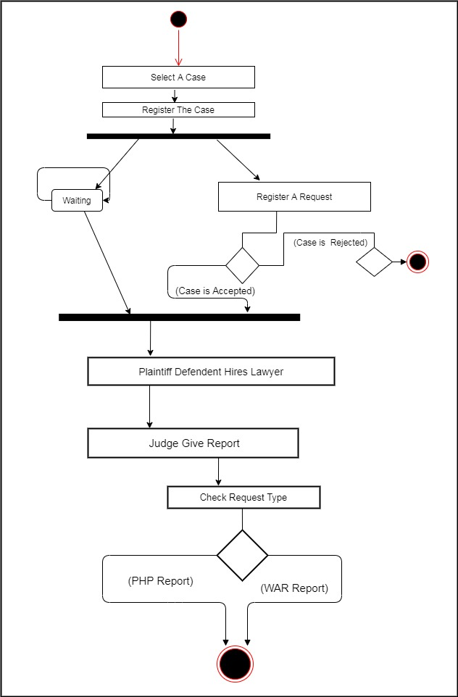

Slide 18
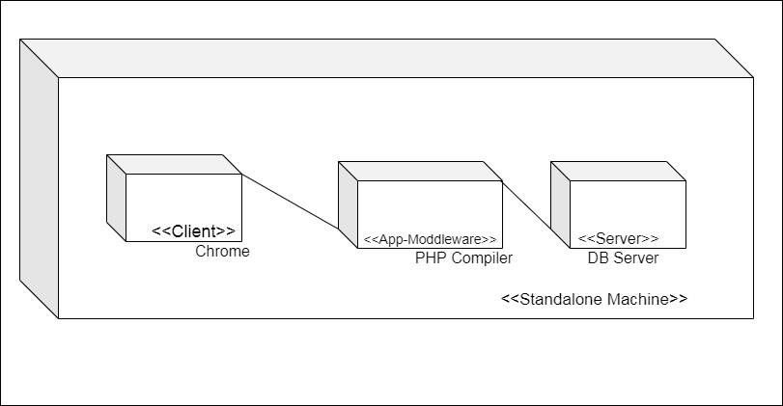

Slide 19
Limitations
Users of this system will not able to save either update their information only admin is the only person who can able to change all the information used in this system.
If user made mistakes while entering data those mistakes could not be corrected by anybody only user has to correct it.
Dynamic Website.
Owner Cannot change the elements of the website.
Need a Developer to update website.

Slide 20
Future Enhancement
There are many things for future enhancement of this project. The future enhancements that are possible in the project are as follows.
Also we can do developments in our system as per requirements changesany time.
Improving dataconsistency.
Developing a flexiblesystem.
Establishing dataintegration.

Slide 21
Resources
www.wikipedia.com
www.github.com
www.kashipara.com

Slide 22
THANKS

